Slide 1

Factory Profile
SOUTH DRAGON DYEING & WASHING LTD.
(Garments Dyeing & Washing Unit)
Address: South Kabirpur,Ashulia,Dhaka-1349
Excellence in Quality
Planet People Product Partners

Slide 2
GROUP TURNOVER $257 Million
TOTAL EMPLOYEES 19,750+
WORDS FROM THE MANAGEMENT
South Dragon Dyeing & Washing Industry Ltd. is an entirely automated yarn dyeing factory. This factory started its commercial production on December 01, 2015. The setup is equipped with fully automated & most up-to-date dyeing technology that guarantees the quality & efficient service. We hope, with the help of all experienced management staff, well-wishers, the commitment of the management & employees, the organization will be able to capture a market share and establish itself as a reliable one.
Management of the Factory
TURNOVER $171 Million
EMPLOYEES 16000+
Chairman
Mrs. Ayerin Alam
ayerin@sdragonbd.com
+8801731-325351
Managing Director
Md. Noor Alam
alam@sdragonbd.com
+8801712-241210
Director
Mr. Meng Jinan
meng@sdragonbd.com
+8801747-008866
ED (Marketing)
Md. Sayfuzzaman Chunnu
chunnu@sdragonbd.com
+8801321-166721
AGM (Admin)
Md. Anamul Haque (Shamim) shamim@sdragonbd.com
+8801321-166706
Production Manager
Md.Razu Ahmed razu@sdragonbd.com
+8801321-166749
Asst. Manager (Admin )
Md. Noman Hasan
noman@sdragonbd.com
+8801321-166709
Account officer
Md.Israfil Hossin israfil@sdragonbd.com
+8801321-166718
TURNOVER $60 Million
EMPLOYEES 100+
TURNOVER $26 Million
EMPLOYEES 2750+

Slide 3
Factory Location: Situated in South Kabirpur, Ashulia, Dhaka. 35 km away from Dhaka International Airport.
Facility: Having all sorts of facilities like: Communications, Water, Gas, and Electricity.
CAPACITY 6 Million PCS
EMPLOYEES 2750+
Our Vision: Be one of the extraordinary dyeing houses, to deliver on-time & quality service to honorable customers.
Mission: To achieve the vision, the company is aiming for a concrete mission:
      Find the actual customer for increasing exports.
      Be a quality service provider.
      Be the on-time service provider.
      Get a clear idea about the customer’s needs & capitalize on ourselves to fulfill all their requirements.
Nature of Business: 100% Export Oriented Sweater & Knit.
Bankers:
Islami Bank Bangladesh Ltd., Uttara Branch, Uttara, Dhaka-1230, Bangladesh
South Bangla Agriculture and Commerce Bank Ltd., Tejgaon Link Road Branch, Tejgaon, Dhaka-1212, Bangladesh
National Credit and Commerce Bank Ltd., Gulsan Branch, Gulsan, Dhaka-1212, Bangladesh

Slide 4
Number of Employees:
Office Staff : 25 Persons
Production Staff : 18 Persons
Lab : 14 Persons
Maintenance Dept : 12 Persons
Piece Dyeing : 45 Persons
Quality : 10 Persons
Dryer : 12 Persons
Hydro : 08 Persons
Acid Wash : 35 Persons
Color Distribution : 02 Persons
Store & Yarn : 10 Persons
Security : 10 Persons
Total Workforce : 201 Persons
Our Specialty
Garment Dyeing
Acid /Stone Wash
Enzyme Wash
Pigment Dyeing
Tie Dyeing
Cold Dyeing
Cold Wash
Burnout
Toil Dye
Deep Dye
Spot wash
Rain Wash

Slide 5
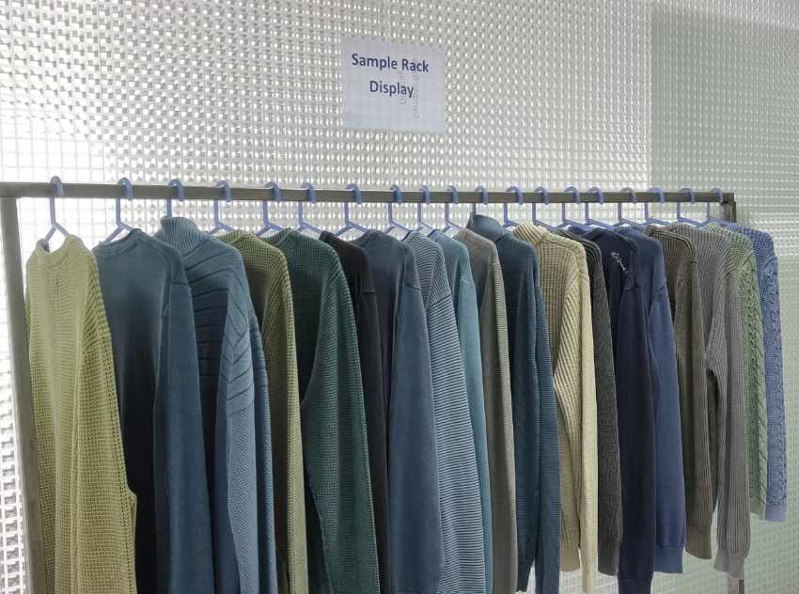
Products Picture

Slide 6
Customers
Audits & Certificates:
Lerros
Zara
Jeans Fritz
Pepe jeans
Assos
H&M
Tom Tailor
OVS
Next
Riplay
Yes Zee
New Yorker
LPP
UBC
Mango
Target
Primark
OEKOTEX
GOTS
OCS

Slide 7
Piece Dyeing Machine:
SL | Description of Machine | Capacity (lbs) | Qty
01 | Piece Dyeing Padel Machine (Fly Yang China) | 600X5 = 3000 | 5 Pcs
02 | Piece Dyeing Padel Machine (Fly Yang China) | 400X1 = 400 | 1 Pc
03 | Piece Dyeing Padel Machine (Fly Yang China) | 200X1 = 200 | 1 Pc
04 | Piece Dyeing Baily Sample Machine (Fly Yang China) | 50X1 = 50 | 1 Pc
05 | Piece Dyeing Padel Sample Machine (Fly Yang China) | 25X1 = 25 | 1 Pc
06 | 4 Chamber Piece Dyeing Padel Sample Machine (Fly Yang China) | 3+5+8 = 16 | 1 Pc
07 | 4 Chamber Piece Dyeing Machine (Fly Yang China) | 3+5+8 = 16 | 1 Pc
08 | Baily Production Machine (Fly Yang China) | 250X5 = 1250 | 5 Pcs
09 | Deep Dyeing Machine (Fly Yang China) | 600+400+250 | 3 Pcs
Piece Dyeing Finishing:
SL | Description of Machine | Capacity (lbs) | Qty
01 | Dryer | 250X09 | 9 Pcs
02 | Hydro-1 , Daill Company .Ltd., Korea | 400 | 1 Pc
03 | Hydro-2 , Daill Company .Ltd., Korea | 400 | 1 Pc
04 | Hydro-3 , Daill Company .Ltd., Korea | 200 | 1 Pc

Slide 8
Acid Wash Machine (Fly Yang, China):
SL | Description of Machine | Capacity (Lbs) | Qty
1 | Acid Wash | 400X5 | 05 Pcs
2 | Baily Sample Acid Wash | 250 | 1 Pc
Laboratory:
SL | Description of Machine | Qty
1 | Shaker Bath-24 Pot | 04 Pcs
2 | Repeat Machine (Fong’s, Model No. SDM2-12-140)-12 Pot | 01 Pc
3 | Color solution maker | 01 Pc
4 | Preset rubbing color fastness tester | 01 Pc
5 | Color fastness test machine (Wash fastness tester) | 01 Pc
6 | Sample circle knitting machine | 01 Pc
7 | Oven dryer | 02 Pcs
8 | Electronic balance | 03 Pcs
9 | Magnetic stirrer hotplate | 02 Pcs
10 | Light box | 02 Pcs
11 | Digital pipette | 02 Pcs
12 | Measuring/Wrap reel | 01 Pc

Slide 9
Utility:
SL | Description of Machine | Company/Origin | Capacity
1 | Electricity | REB/BD | 1000 KW
2 | Gas Generator | Caterpillar | 510 KW
3 | Gas Generator | Caterpillar | 360 KW
4 | Boiler | EPCB | 6000 KG/HR
5 | Water Treatment Plant |  | 140 M³/HR
6 | Effluent Treatment Plant |  | 100 M³/HR
W.T. P. Section
SL | Description of Machine | Power (KW) | Qty
1 | Submersible Pump (30HP & 25 HP 127 m3 ( Jonson) | 41 | 2 Pcs
2 | Centrifugal Pump10 Kw (Siemens) | 40 | 4 Pcs

Slide 10
Association:
Member - Bangladesh Dyed Yarn Exporters Association (BDYEA)
Contact Persons:
Md. Noor Alam
Managing Director
alam@sdragonbd.com
+8801712-241210
Md. Razu Ahmed
PM (Production)
razu@sdragonbd.com
+8801321-166749

Slide 11
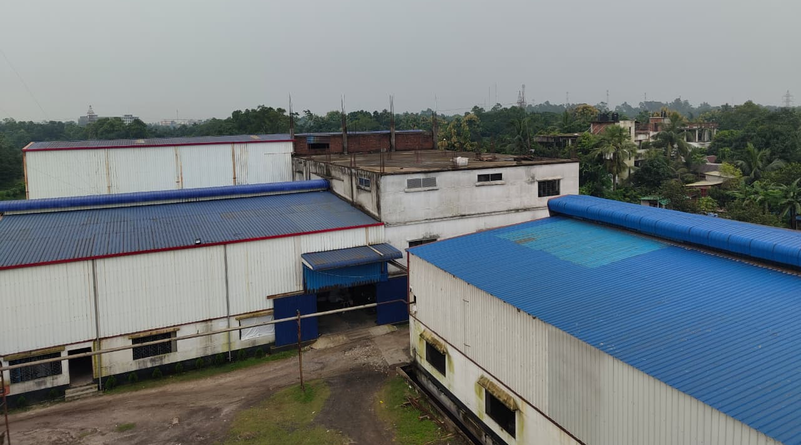
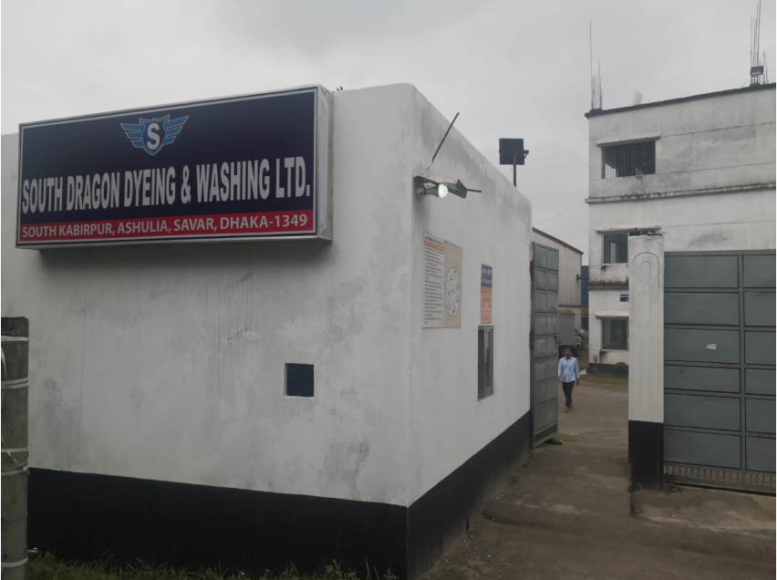
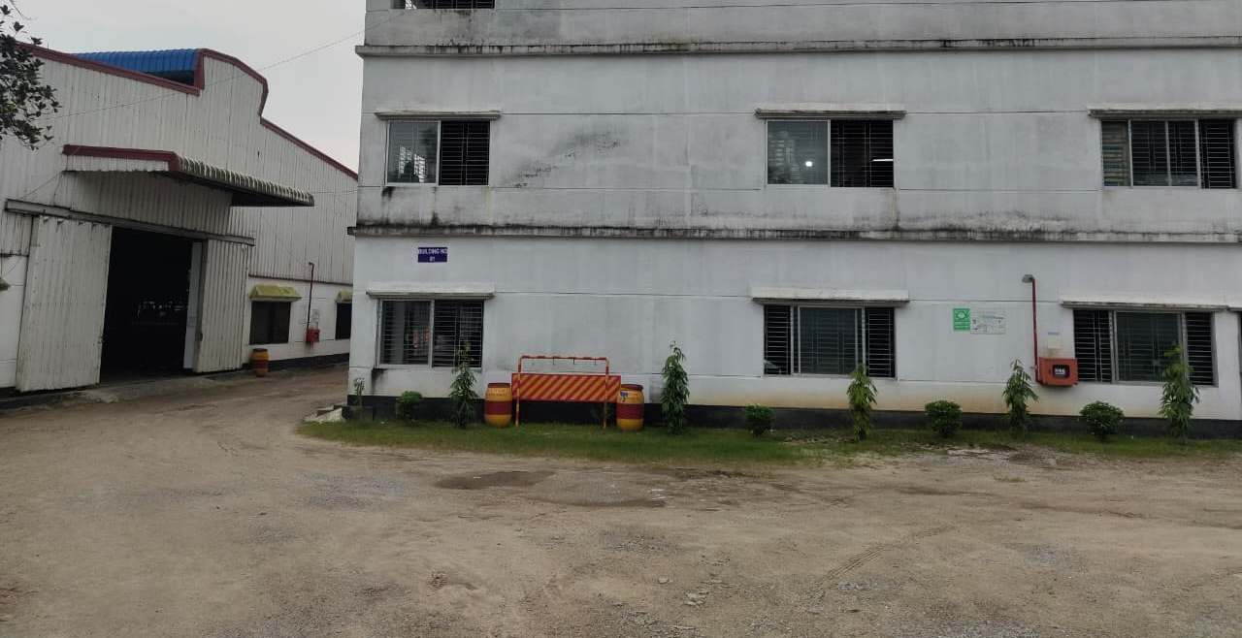
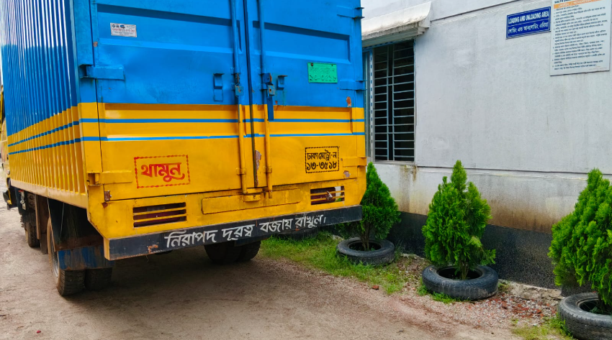
Factory Photos

Slide 12
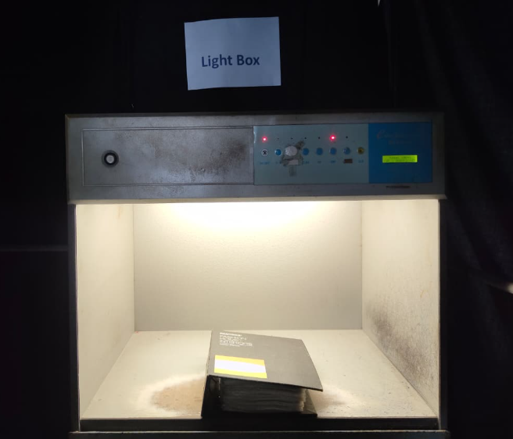
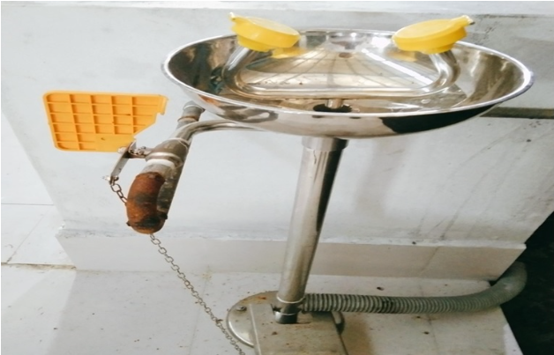
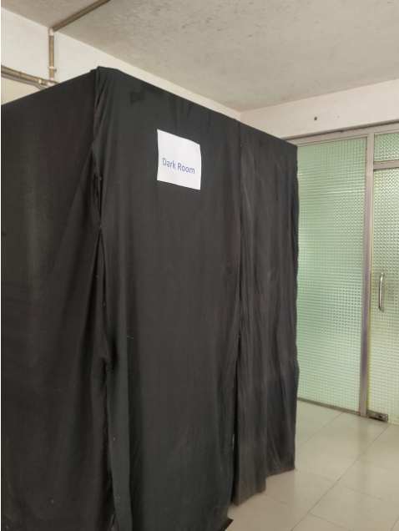
Equipment

Slide 13
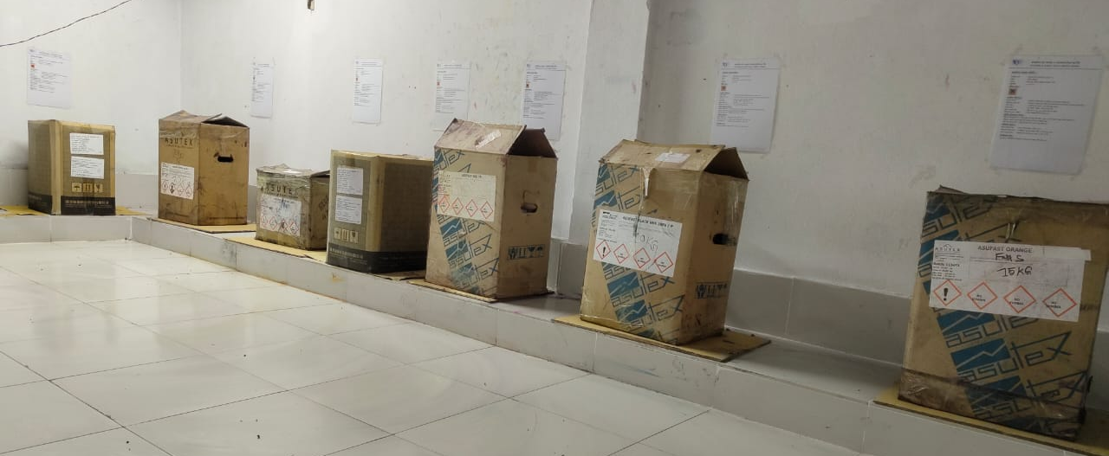
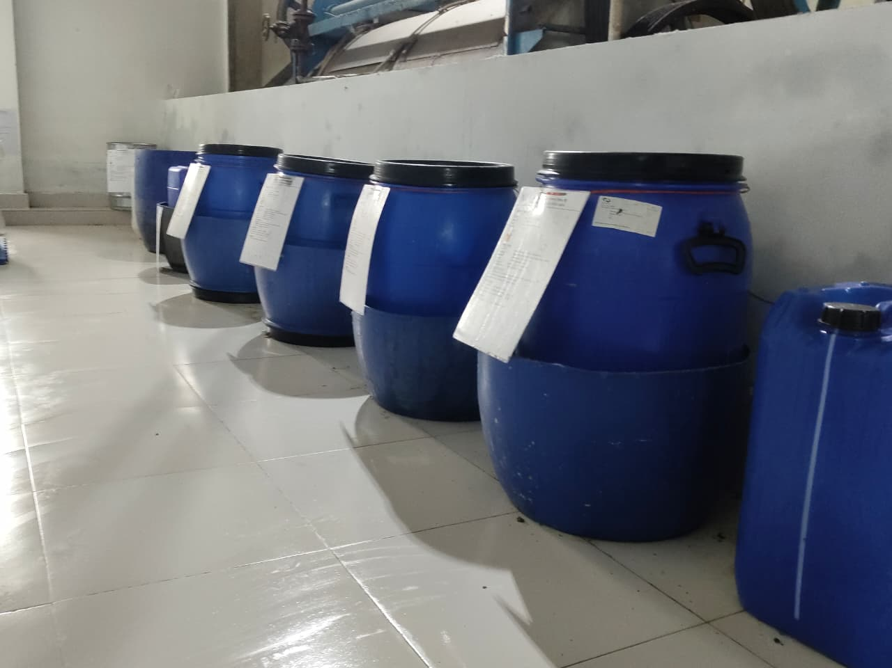
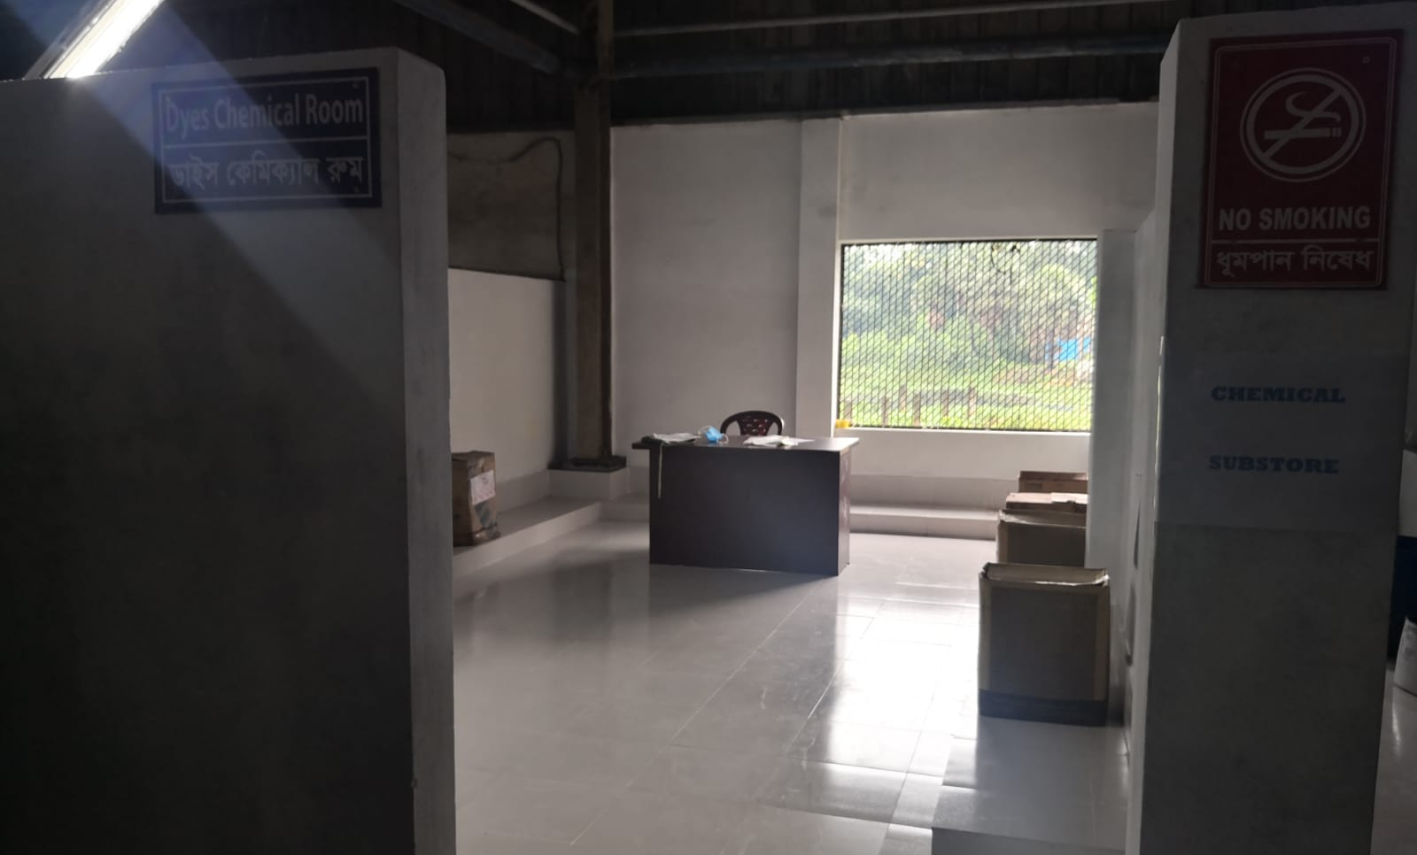
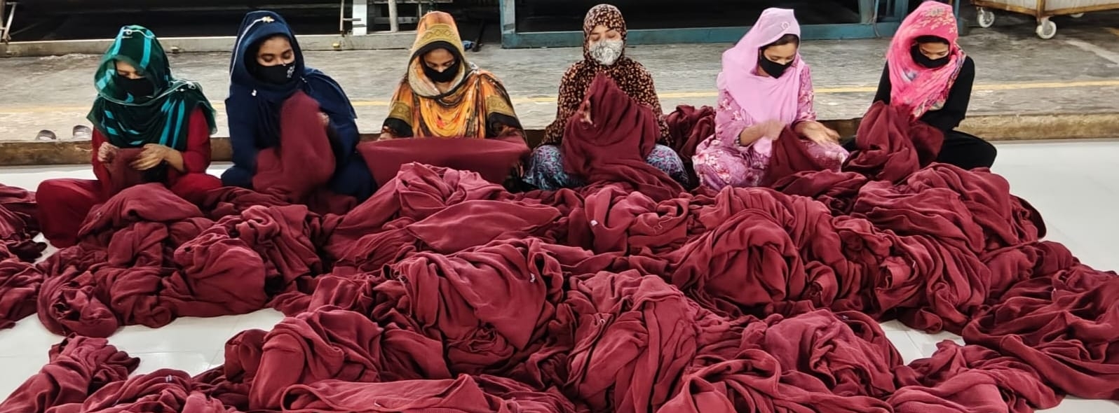
Storage

Slide 14
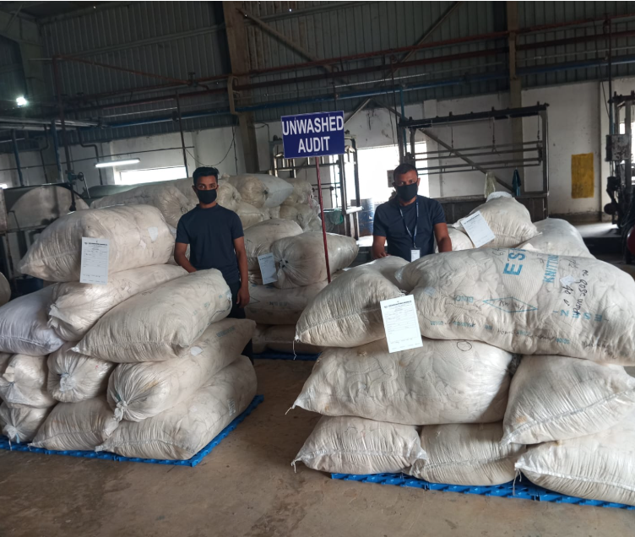
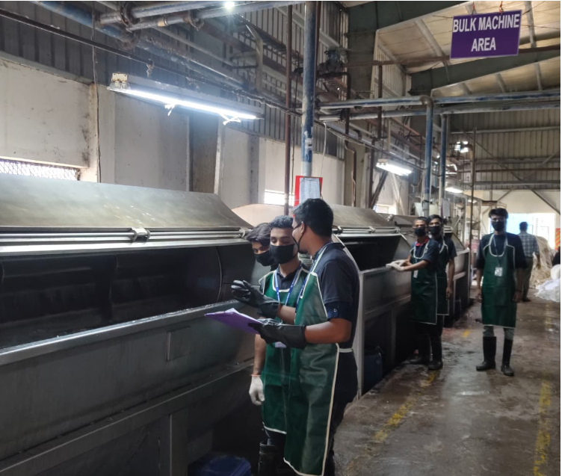
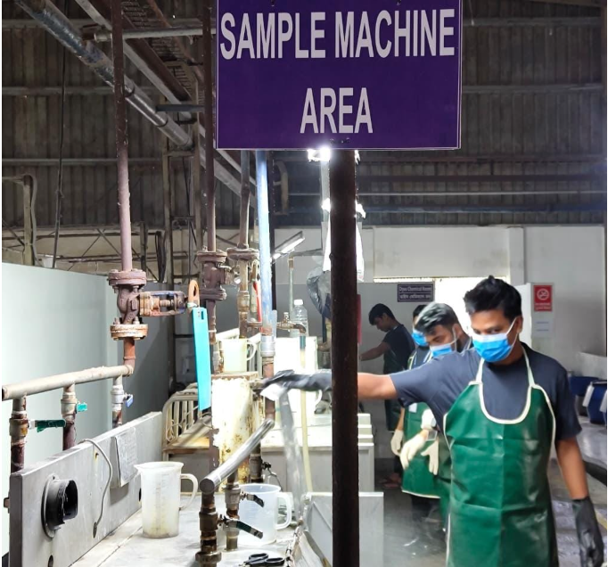
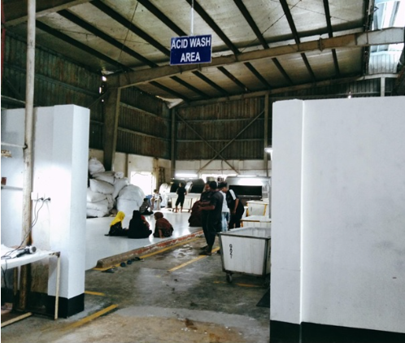
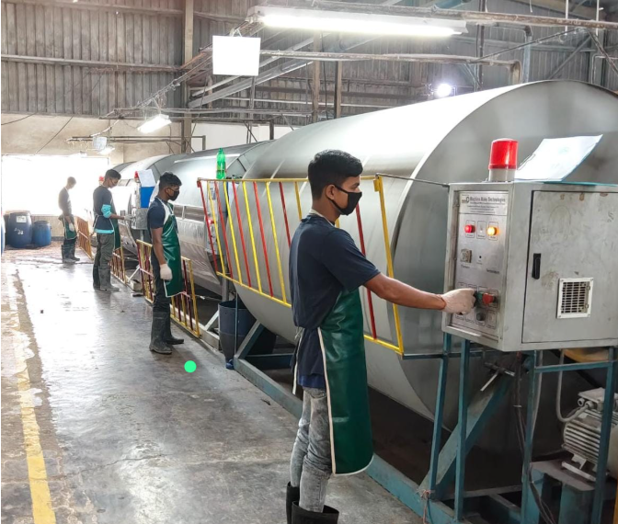
Washing Section

